Slide 1
Accounting Principles, 7th Edition
Weygandt • Kieso • Kimmel
Chapter 6
Inventories
Prepared by Naomi Karolinski
Monroe Community College
and
Marianne Bradford
Bryant College
John Wiley & Sons, Inc. © 2005

Slide 2
CHAPTER 6 INVENTORIES
After studying this chapter, you should be able to:
Describe steps in determining inventory quantities
Explain the basis of accounting for inventories and describe the inventory cost flow methods
Explain the financial statements and the tax effects of each inventory cost flow method
Explain the lower of cost or market basis of accounting for inventories
Indicate the effects of inventory errors on the financial statements
Compute and interpret inventory turnover

Slide 3
INVENTORY BASICS
Balance sheet of merchandising and manufacturing companies
  inventory significant current asset
Income statement
  inventory is vital in determining results
Gross profit
  (net sales - cost of goods sold)
    watched by management, owners, and others

Slide 4
MERCHANDISE INVENTORY CHARACTERISTICS
Merchandise inventory
1 Owned by the company
2 In a form ready for sale

Slide 5



CLASSIFYING INVENTORY IN A MANUFACTURING ENVIRONMENT
Manufacturing inventories
  may not yet be ready for sale
Classified into three categories:
1 Finished goods
ready for sale
2 Work in process
various stages of production
(not completed)
3 Raw materials
components on hand waiting to be used

Slide 6
DETERMINING INVENTORY QUANTITIES
STUDY OBJECTIVE 1
To prepare financial statements determine
the number of units in inventory by taking a physical inventory of goods on hand physical inventory by counting, weighing or measuring
The ownership of goods

Slide 7
DETERMINING COST OF GOODS ON HAND
3. apply unit costs to the total units on hand for each item
total the cost of each item of inventory to determine total cost of goods on hand

Slide 8
TAKING A PHYSICAL INVENTORY
Internal control principles for inventory:
1 Segregation of duties
counting by employees not having custodial responsibility for the inventory
2 Establishment of responsibility
each counter should establish the authenticity of each inventory item

Slide 9
TAKING A PHYSICAL INVENTORY
3 Independent internal verification
second count by another employee
4 Documentation procedures
pre-numbered inventory tags
5 Independent internal verification
designated supervisor checks all inventory items tags, no items have more than one tag

Slide 10

OWNERSHIP OF GOODS IN TRANSIT
Goods in transit:
included in the inventory of the party that has legal title to the goods
FOB (Free on Board) shipping point:
ownership of the goods passes to the buyer when the public carrier accepts the goods from the seller
FOB destination point:
legal title to the goods remains with the seller until the goods reach the buyer

Slide 11
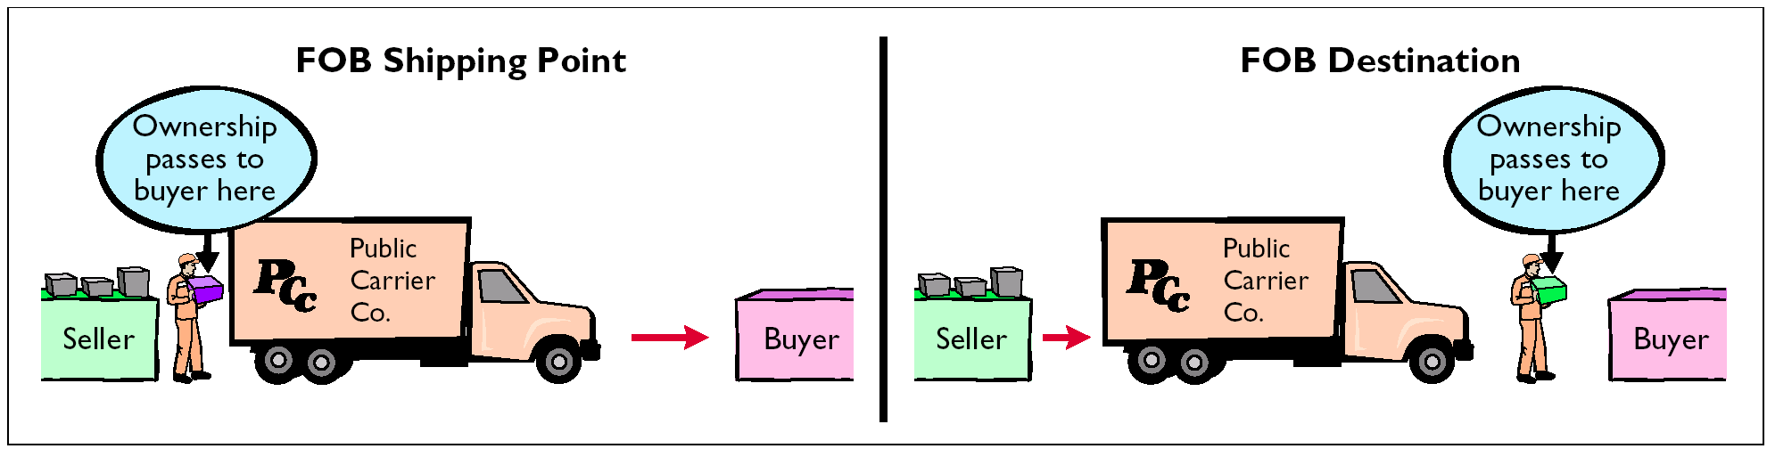
TERMS OF SALE

Slide 12

CONSIGNED GOODS
Consignment:
the holder of the goods (consignee) does not own the goods
  ownership remains with the consignor of the goods until the goods are sold
  consigned goods should be included in the consignor’s inventory, not the consignee’s inventory
Owned by a consignor; do not count in consignee inventory
Consignee Company

Slide 13
INVENTORY ACCOUNTING SYSTEMS
1 Perpetual
detailed records
cost of each item maintained
cost of each item sold is determined when sale occurs
2 Periodic
cost of goods sold is determined at the end of accounting period

Slide 14
Basis of Accounting for Inventories
Periodic Cost Flow Methods
STUDY OBJECTIVE 2
Revenues from the sale of merchandise are recorded when sales are made in the same way as in a perpetual system.
No calculation of cost of goods sold is made at the time of sale of the merchandise.
Physical inventories are taken at end of period to determine:
  the cost of merchandise on hand
  the cost of the goods sold during the period
Notes:
New Slide needed.

Slide 15
ALLOCATING INVENTORIABLE COSTS
Inventory costs- periodic inventory system
  allocated between ending inventory and cost of goods sold
  allocation is made at the end of the accounting period
1 the costs assignable to the ending inventory are determined
2 the cost of the ending inventory is subtracted from the cost of goods available for sale to determine the cost of goods sold
3 cost of goods sold is then deducted from sales revenues in accordance with the matching principle to get gross profit

Slide 16
COST OF GOODS SOLD
Cost of Goods Sold –Review
Periodic inventory system
Three steps are required:
record purchases of merchandise,
determine the cost of goods purchased,
determine the cost of goods on hand at the beginning and end of the accounting period

Slide 17
DETERMINING COST OF GOODS PURCHASED
To determine Cost of Goods Purchased:
1 subtract contra purchase accounts of Purchases Discounts and Purchases Returns and Allowances from Purchases to get Net Purchases
2 add Freight-in to Net Purchases

Slide 18
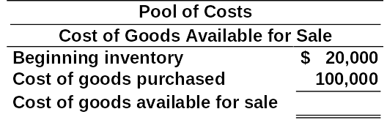
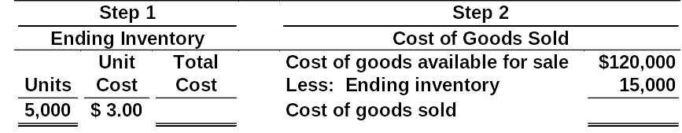
ALLOCATION (MATCHING) OF POOL OF COSTS
STUDY OBJECTIVE 5
$ 120,000
$15,000 $105,000

Slide 19
The cost of goods available for sale is allocated between
a. beginning inventory and ending inventory.
b. beginning inventory and cost of goods on hand.
c. cost of goods purchased and cost of goods sold.
d. beginning inventory and cost of goods purchased.

Slide 20
The cost of goods available for sale is allocated between
a. beginning inventory and ending inventory.
b. beginning inventory and cost of goods on hand.
c. cost of goods purchased and cost of goods sold.
d. beginning inventory and cost of goods purchased.

Slide 21
USING ACTUAL PHYSICAL
FLOW COSTING
Costing of the inventory is complicated because specific items of inventory on hand may have been purchased at different prices.
The specific identification method tracks the actual physical flow of the goods.
Each item of inventory is marked, tagged, or coded with its specific unit cost.
Items still in inventory at the end of the year are specifically costed to arrive at the total cost of the ending inventory.

Slide 22
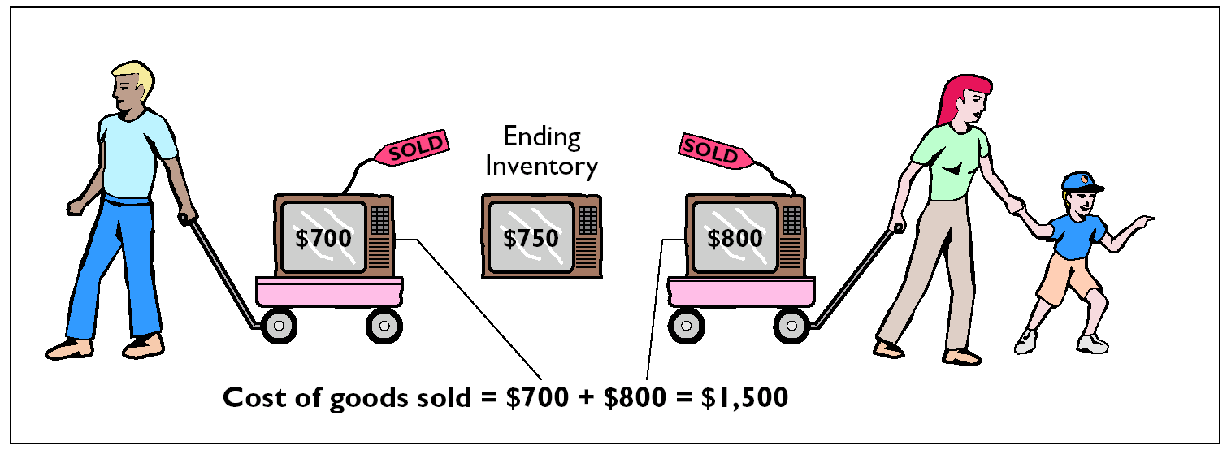
SPECIFIC IDENTIFICATION METHOD

Slide 23
USING ASSUMED COST FLOW METHODS
Other cost flow methods are allowed since specific identification is often impractical.
These methods assume flows of costs that may be unrelated to the physical flow of goods.
For this reason we call them assumed cost flow methods or cost flow assumptions. They are:
1 First-in, first-out (FIFO).
2 Last-in, first-out (LIFO).
3 Average cost.

Slide 24
FIFO
The FIFO method
  earliest goods purchased are the first to be sold.
  often parallels the actual physical flow of merchandise.
  the costs of the earliest goods purchased are the first to be recognized as cost of goods sold.

Slide 25
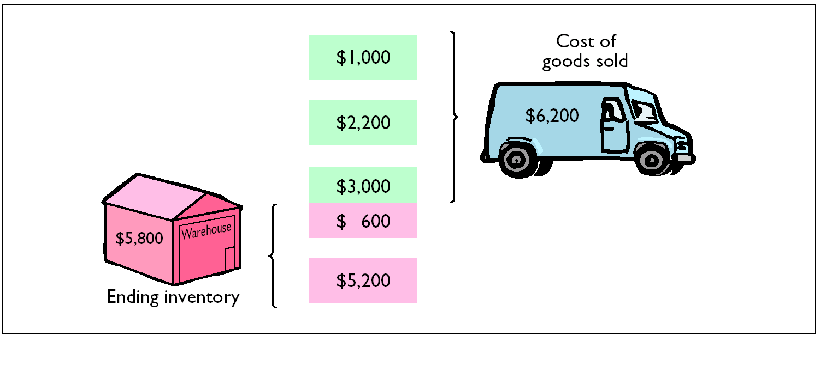
FIFO

Slide 26
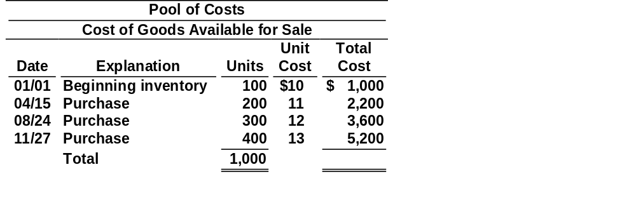
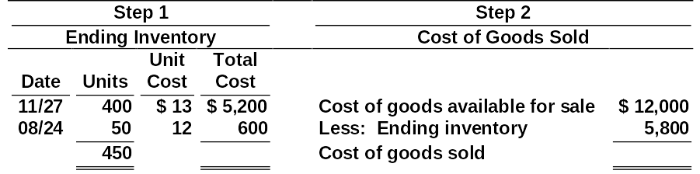
ALLOCATION OF COSTS - FIFO METHOD
$ 5,800 $ 6,200
$ 12,000

Slide 27
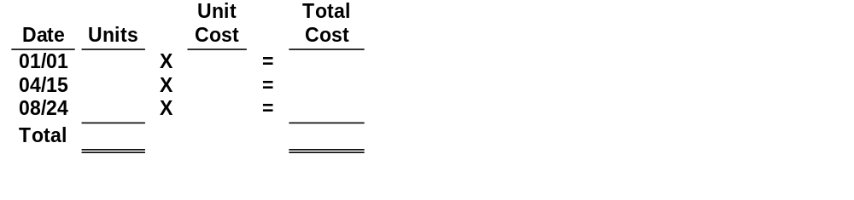
PROOF OF COST OF GOODS SOLD
The accuracy of the cost of goods sold can be verified by recognizing that the first units acquired are the first units sold.
100 $ 10 $ 1,000 200 11 2,200 250 12 3,000
550 $ 6,200

Slide 28
LIFO
The LIFO method assumes that the latest goods purchased are the first to be sold.
LIFO seldom coincides with the actual physical flow of inventory.
Under LIFO, the costs of the latest goods purchased are the first goods to be sold.

Slide 29
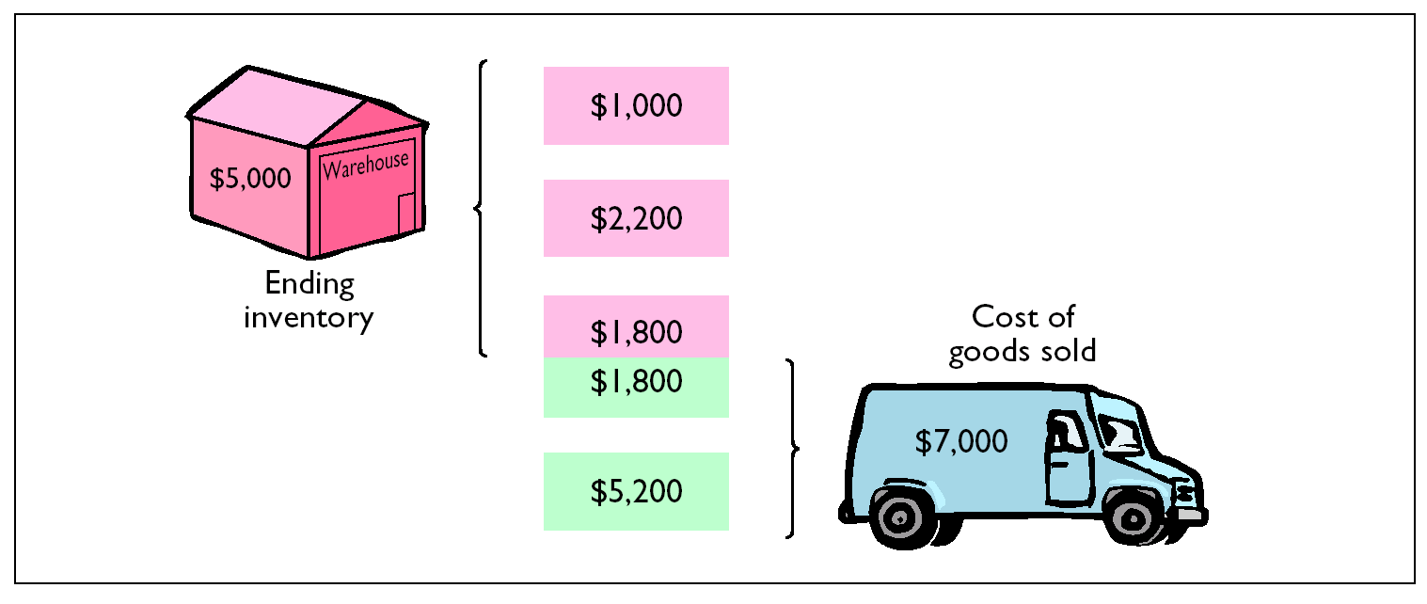
LIFO

Slide 30
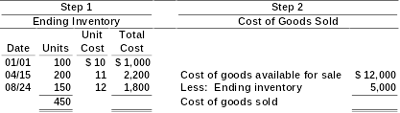
ALLOCATION OF COSTS - LIFO METHOD
$ 12,000
$ 5,000 $ 7,000

Slide 31
PROOF OF COST OF GOODS SOLD
The cost of the last goods in are the first to be assigned to cost of goods sold. Under a periodic inventory system, all goods purchased during the period are assumed to be available for the first sale, regardless of the date of purchase.
Unit
Total
Date
Units
Cost
Cost
11/27
X
=
400 $ 13 $ 5,200 150 12 1,800
550 $ 7,000
08/24
X
=
Total

Slide 32
AVERAGE COST
The average cost method
  assumes goods available for sale are homogeneous.
  the cost of goods available for sale is allocated on the basis of the weighted average unit cost incurred.
  weighted average unit cost is applied to the units on hand to determine cost of the ending inventory.

Slide 33
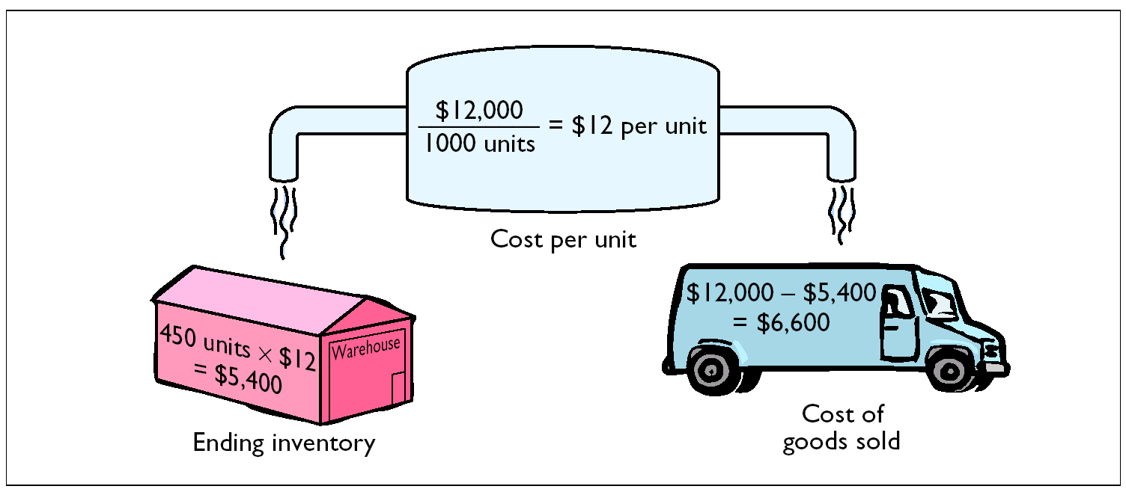
AVERAGE COST

Slide 34
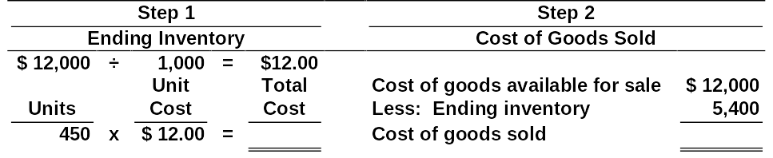
ALLOCATION OF COSTS - AVERAGE COST METHOD
$ 12,000
$ 5,400 $ 6,600

Slide 35
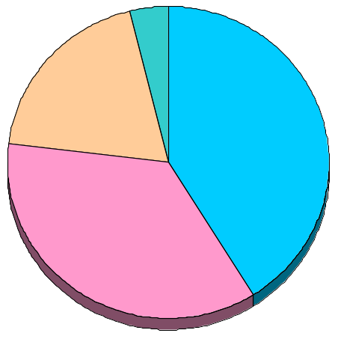

USE OF COST FLOW METHODS IN MAJOR U.S. COMPANIES
Companies adopt different inventory cost flow methods for various reasons. Usually one of the following factors is involved: 1) income statement effects, 2) balance sheet effects, or 3) tax effects.
21% Average Cost
5% Other
44% FIFO
30% LIFO

Slide 36
A company had the following inventory information for the month of May:
May 1 | Beg. Inventory | 400 units | @ | $10.00 = | $ 4,000
8 | Purchase | 500 units | @ | $10.50 = | $ 5,250
20 | Purchase | 600 units | @ | $10.60 = | $ 6,360
Total units 1,100 |  |  |  |  | $15,610
Assuming the company is using the Lifo method of inventory: Calculate the value of the ending inventory if there are 100 units in ending inventory on May 31st.

Slide 37
Under LIFO, the ending inventory consists of the oldest 100 units, therefore ending inventory = 100 units X $10 = $1,000.

Slide 38
INCOME STATEMENT EFFECTS COMPARED
STUDY OBJECTIVE 3
Kralik Company buys 200 XR492s at $20 per unit on January 10 and 200 more on December 31 at $24 each. During the year, 200 units are sold at $30 each. Under LIFO, the company recovers the current replacement cost ($4,800) of the units sold. Under FIFO, however, the company recovers only the January 10 cost ($4,000). To replace the units sold, it must invest $800 (200 x $4) of the gross profit. Thus, $800 of the gross profit is said to be phantom or illusory profits. As a result, reported net income is overstated in real terms.
LIFO FIFO
Cost of goods sold 4,000 (200 x $20) 4,800 (200 x $24)

Slide 39
USING INVENTORY COST FLOW METHODS CONSISTENTLY
Consistency
  Companies needs to use its chosen cost flow method from one period to another.
  Consistent application makes financial statements comparable over successive time periods.
  If a company adopts a different cost flow method:
    The change and its effects on net income must be disclosed in the financial statements

Slide 40
VALUING INVENTORY AT THE LOWER OF COST OR MARKET
STUDY OBJECTIVE 4
Value of inventory is lower than its cost
  The inventory is written down to its market value
Known as the lower of cost or market (LCM) method
LCM basis
  Market is defined as current replacement cost, not selling price

Slide 41
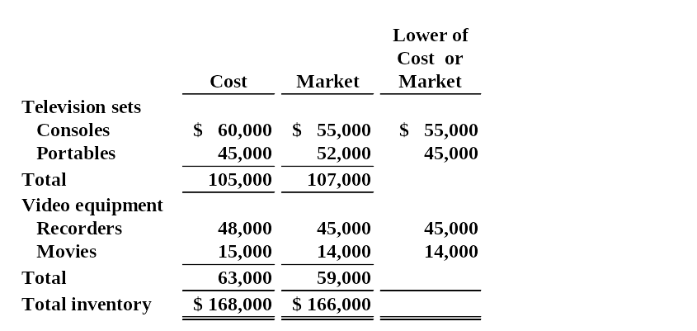
COMPUTATION OF LOWER OF
COST OR MARKET
$ 159,000

Slide 42

INVENTORY ERRORS - INCOME STATEMENT EFFECTS
STUDY OBJECTIVE 5
both beginning and ending inventories appear on the income statement
ending inventory of one period automatically becomes the beginning inventory of the next period
inventory errors
  affect the determination of cost of
  goods sold and net income

Slide 43
FORMULA FOR COST OF GOODS SOLD
Beginning
Inventory
Cost of
Goods
Purchased
Ending
Inventory
Cost of
Goods
Sold
+
_
=
the effects on cost of goods sold can be determined by entering the incorrect data in the above formula and then substituting the correct data

Slide 44

EFFECTS OF INVENTORY ERRORS ON CURRENT YEAR’S INCOME STATEMENT
Understate beginning inventory Understated Overstated
Overstate beginning inventory Overstated Understated
Understate ending inventory Overstated Understated
Overstate ending inventory Understated Overstated
An error in ending inventory of the current period will have a reverse effect on net income of the next period.

Slide 45
ENDING INVENTORY ERROR - BALANCE SHEET EFFECTS
the effect of ending inventory errors on the balance sheet can be determined by the basic accounting equation:
Assets = Liabilities + Owners Equity

Slide 46

ENDING INVENTORY ERROR - BALANCE SHEET EFFECTS
Errors in the ending inventory have the following effects on these components:
Overstated Overstated None Overstated Understated Understated None Understated

Slide 47
INVENTORY DISCLOSURES
Inventory
  classified as a current asset after receivables in the balance sheet
Cost of goods sold
  subtracted from sales in the income statement
Disclosure either in the balance sheet or in accompanying notes for:
1 major inventory classifications
2 basis of accounting (cost or lower of cost or market)
3 costing method (FIFO, LIFO, or average cost)
Wal-Mart Stores, Inc
Notes to the Financial Statements
Note 1. Summary of accounting policies
Inventories
The company uses the retail, last-in, first-out (LIFO) method for the Wal-Mart Stores segment, cost LIFO for the SAM’S CLUB segment, and other cost methods, including the retail first-in, first-out (FIFO) and average costs methods, for the International segment. Inventories are not recorded in excess of market value.

Slide 48
INVENTORY TURNOVER FORMULA AND COMPUTATION
STUDY OBJECTIVE 6
The inventory turnover ratio measures the number of times, on average, the inventory is sold during the period – which measures the liquidity of the inventory. It is computed by dividing cost of goods sold by average inventory during the year. Assume that Wal-Mart, Inc. has a beginning inventory of $21,442 million and ending inventory of $21,614 and cost of goods sold for 2002 of $171,562; its inventory turnover formula and computation is shown below:
COST OF GOODS SOLD INVENTORY TURNOVER = ———————————— AVERAGE INVENTORY
7.97 times = $171,562
($21,442 + $21,614) /2

Slide 49
APPENDIX 6A
INVENTORY COST FLOW METHODS IN PERPETUAL INVENTORY SYSTEMS
To illustrate the application of the 3 assumed cost flow methods (FIFO, Average Cost, and LIFO), the data shown below for Bow Valley Electronics’ product Z202 Astro Condenser is used.
Bow Valley Electronics
Z202 Astro Condensers
Unit
Total
Date
Explanation
Units
Cost
Cost
01/01
Beginning inventory
100
$10
$ 1,000
04/15
Purchase
200
11
2,200
08/24
Purchase
300
12
3,600
11/27
Purchase
400
13
5,200
Total
$ 12,000
Notes:
Fix the heading.

Slide 50
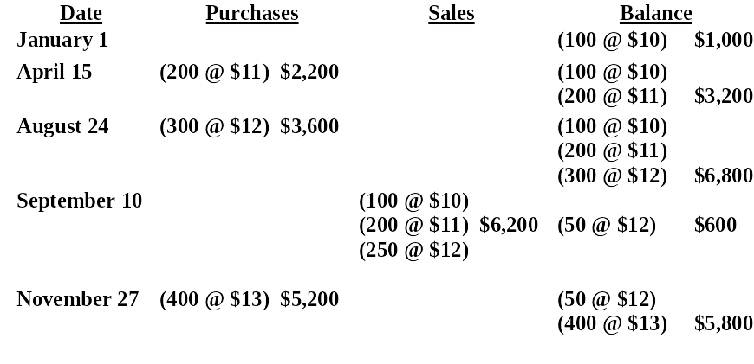
PERPETUAL SYSTEM - FIFO
Under FIFO, the cost of the earliest goods on hand prior to each sale is charged to cost of goods sold. Therefore, the cost of goods sold on September 10 consists of the units on hand January 1 and the units purchased April 15 and August 24.

Slide 51
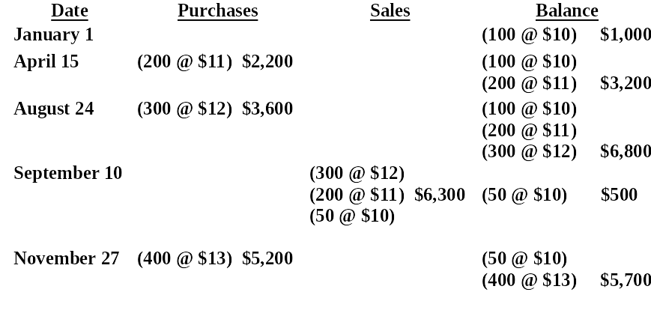
PERPETUAL SYSTEM - LIFO
Under the LIFO method using a perpetual system, the cost of the most recent purchase prior to sale is allocated to the units sold. The cost of the goods sold on September 10 consists entirely of goods from the August 24 and April 15 purchases and 50 of the units in beginning inventory.
Notes:
Fix Me

Slide 52
PERPETUAL SYSTEM - AVERAGE COST
The average cost method in a perpetual inventory system is called the moving average method. Under this method a new average is computed after each purchase. The average cost is computed by dividing the cost of goods available for sale by the units on hand. The average cost is then applied to
the units sold, to determine the cost of goods sold, and,
the remaining units on hand, to determine the ending inventory amount.

Slide 53
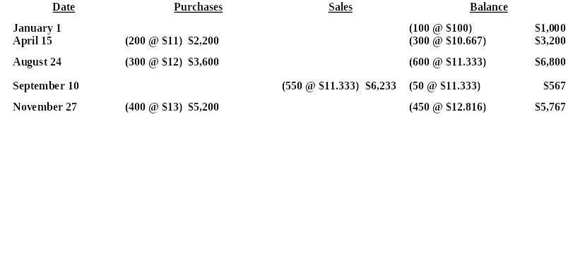
PERPETUAL SYSTEM -
AVERAGE COST METHOD
As indicated below, a new average is computed each time a purchase is made. On April 15, after 200 units are purchased for $2,200, a total of 300 units costing $3,200 ($1,000 + $2,200) are on hand. The average cost is $10.667 ($3,200/300).

Slide 54

APPENDIX 6B
ESTIMATING INVENTORIES
Two circumstances for estimating
inventories:
1 management may want monthly or quarterly financial statements, but a physical inventory is usually only taken annually.
2 a casualty such as a fire or flood may make it impossible to take a physical inventory.
Two widely used methods of estimating inventories:
1 the gross profit method and
2 the retail inventory method

Slide 55
GROSS PROFIT METHOD
Gross profit method
  Estimates the cost of ending inventory by applying a gross profit rate to net sales
used in preparing monthly financial statements under a periodic system
should NOT be used in preparing the company’s financial statements at year-end
is assumed to remain constant from one year to the next

Slide 56
GROSS PROFIT METHOD FORMULAS
Step 1 Net sales less estimated gross profit equals estimated cost of goods sold.
Estimated
Gross
Profit
Estimated
Cost of
Goods Sold
Net Sales
Cost of Goods
Available for
Sale
Estimated
Cost of
Goods Sold
Estimated
Cost of
Ending Inventory
Step 2 Cost of goods available for sale less estimated cost
of goods sold (from Step 1) equals the estimated cost of
ending inventory.

Slide 57

RETAIL INVENTORY METHOD
A store has many different types of merchandise at low unit costs
  the retail inventory method is often used
  a company’s records must show both the cost and retail value of the goods available for sale
Major disadvantage
  it is an averaging technique

Slide 58
RETAIL INVENTORY METHOD FORMULAS
Goods
Available for
Sale at Retail
Ending
Inventory
at Retail
Step 1
Net Sales
Goods
Available for
Sale at Cost
Goods
Available for
Sale at Retail
Cost to
Retail
Ratio
Step 2
Ending
Inventory
at Retail
Cost to
Retail
Ratio
Estimated
Cost of
Ending
Inventory
Step 3

Slide 59
DETERMINING COST OF GOODS ON HAND
Under the periodic method, cost of inventory on hand is determined from a physical inventory requiring:
1 counting the units on hand for each item of inventory
2 applying unit costs to the total units on hand for each item
3 totaling the cost of each item of inventory to determine total cost of goods on hand

Slide 60
A company had the following inventory information for the month of May:
May 1 | Beg. Inventory | 400 units | @ | $10.00 = | $ 4,000
8 | Purchase | 500 units | @ | $10.50 = | $ 5,250
20 | Purchase | 600 units | @ | $10.60 = | $ 6,360
Total units and cost 1,500 |  |  |  |  | $15,610
Assuming the company is using the LIFO method of inventory: Calculate the value of the ending inventory if there are 100 units in ending inventory on May 31.

Slide 61
A company had the following inventory information for the month of May:
May 1 | Beg. Inventory | 400 units | @ | $10.00 = | $ 4,000
8 | Purchase | 500 units | @ | $10.50 = | $ 5,250
20 | Purchase | 600 units | @ | $10.60 = | $ 6,360
Total units and cost 1,500 |  |  |  |  | $15,610
Assume an ending inventory of 100 units, then ending inventory would consist of the oldest layer: 100 units @ $10.00 = $1,000 (Cost of Goods sold would be equal to (Cost of Goods available for Sale - Ending Inventory)
$15,610-$1,000= $14,610

Slide 62

COPYRIGHT
Copyright © 2005 John Wiley & Sons, Inc. All rights reserved. Reproduction or translation of this work beyond that permitted in Section 117 of the 1976 United States Copyright Act without the express written consent of the copyright owner is unlawful. Request for further information should be addressed to the Permissions Department, John Wiley & Sons, Inc. The purchaser may make back-up copies for his/her own use only and not for distribution or resale. The Publisher assumes no responsibility for errors, omissions, or damages, caused by the use of these programs or from the use of the information contained herein.

